Slide 1

OList Marketing and Retail Analytics: Capstone Project
Please click on the sound button for voiceover during slides
PRATIKSHA MAZUMDER
Chandni RAJP00T
A v sailaja

Slide 2
Agenda
Objectives
Background
Visualizations
Insights
Recommendations
Appendix –
Data Sources
Data Methodology
Data Assumptions

Slide 3
Objective
To identify Top products that contribute to the revenue and top product category .
Improve our understanding with the use of market basket analysis to analyze the purchase behavior of customers.
Understand what items are most likely to be purchased individually or in combination with some other products.
Utilize Pareto Analysis to pinpoint key revenue-contributing products and dominant product categories. Enhance insights through market basket analysis to delve into customer purchasing behavior.
Gain insight into the individual purchase likelihood of items and their propensity for combination with other products.

Slide 4
Background
In light of recent financial challenges, OList, a prominent e-commerce enterprise, is prioritizing inventory management to curtail superfluous expenditures.
Meeting the demands of its customer base entails the substantial storage of diverse products within warehouses, thereby amplifying operational costs.
Recognizing the significance of this aspect, the organization is intensifying efforts towards strategic inventory planning to ensure resource optimization and cost-effectiveness in its operations.

Slide 5
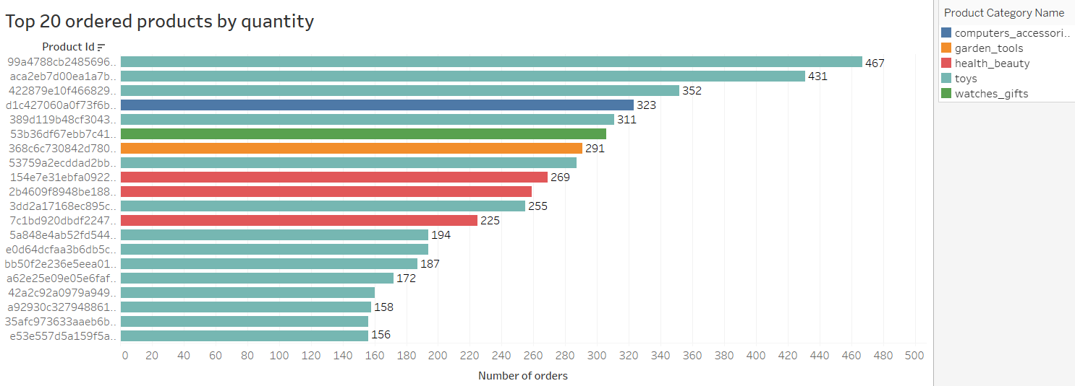
Top 20 Ordered Products by Quantity
The Toys category boasts the highest-selling product, with a total of 467 orders.
The majority of items in the Top 20, known for their frequent orders, also fall within the Toys category.

Slide 6
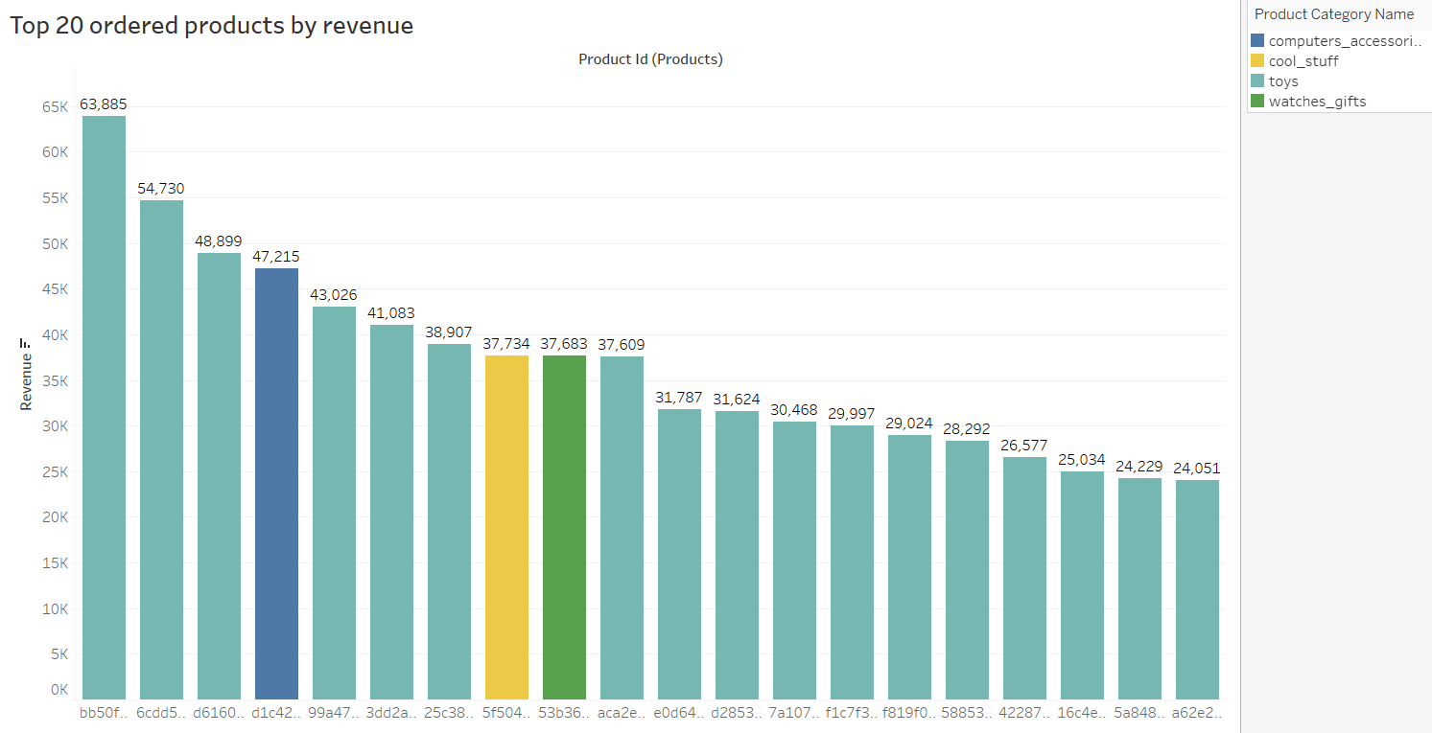
Top 20 Ordered Products by Revenue
The Toys category tops revenue charts, generating ₹63,885, with its top-selling product.
Most of the Top 20 revenue-generating items also hail from the Toys category..

Slide 7
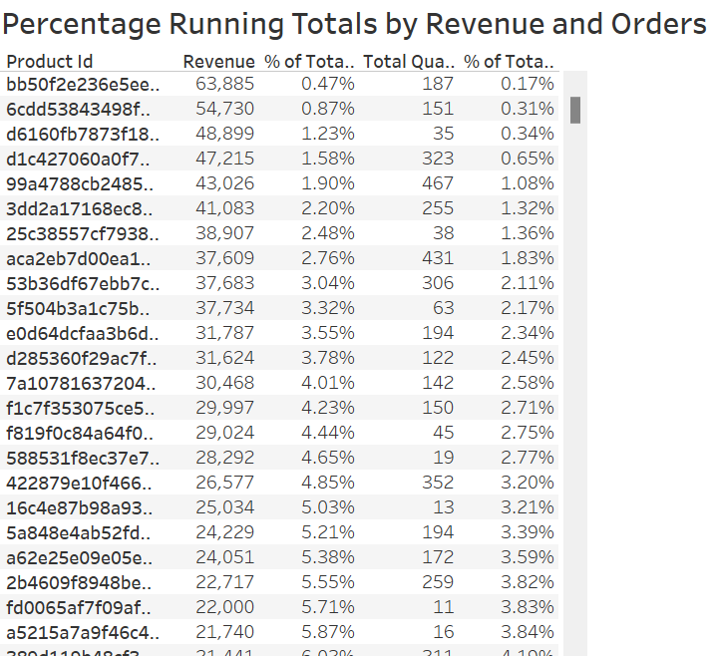
Percent Running Totals
The Percentage of Total Running Revenue and Quantity Ordered has been broken down by Product Id.
The contribution of each product towards the total revenue can be identified.

Slide 8
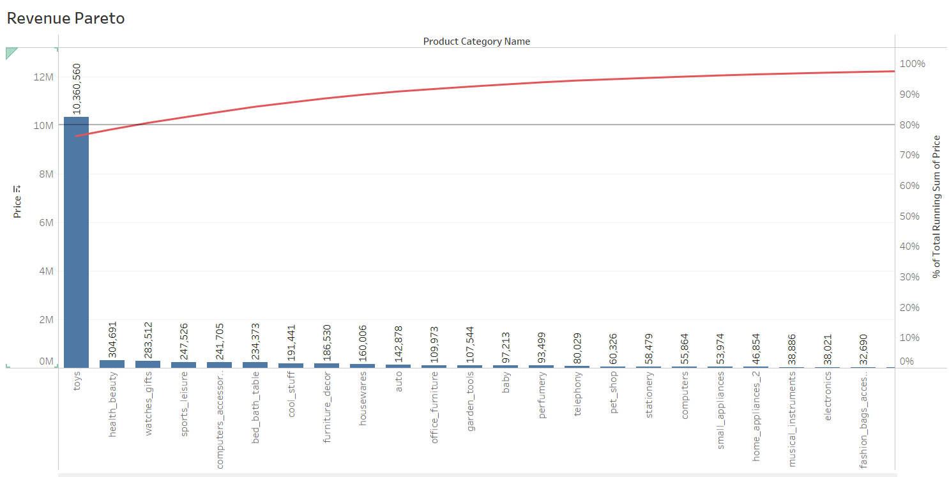
Revenue Pareto
Toys, health_beauty and watches_gift combine generate 80.56% of the revenue.
Toys alone generates 76.23% of the revenue.
The rest of the 70+ product categories generates 19.44% of the revenue.

Slide 9
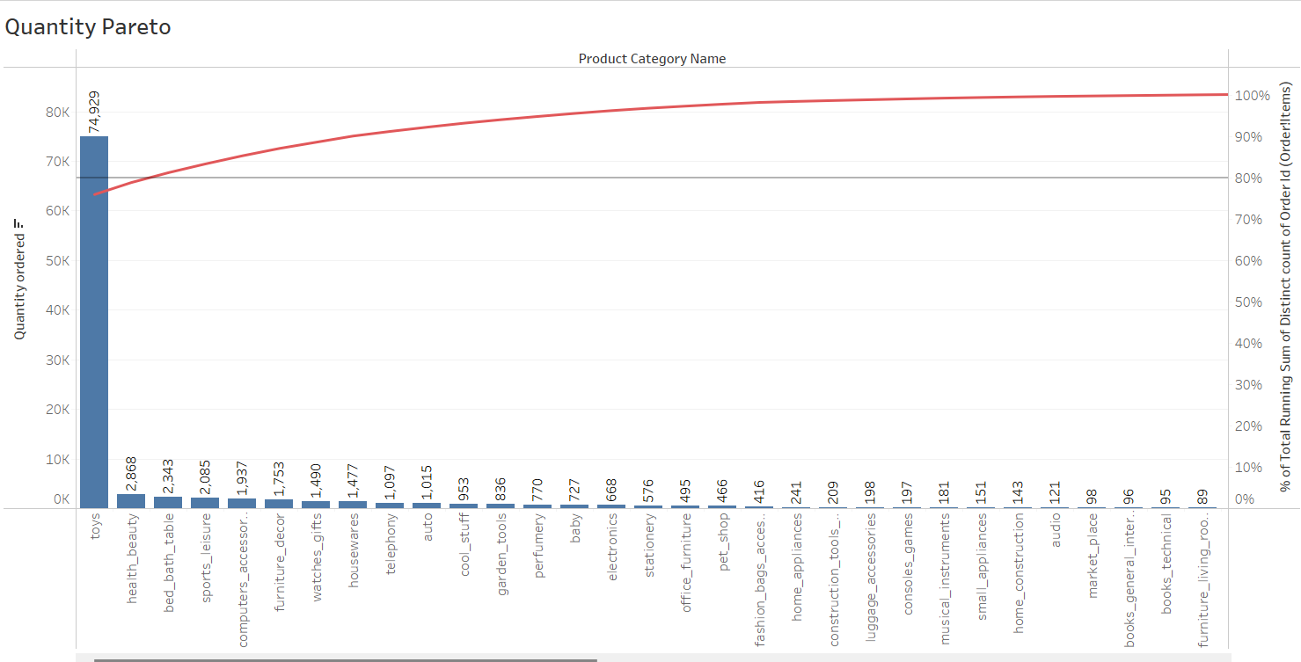
Quantity Pareto
Toys, health_beauty and bed_bath_table make up 80.38% of the total orders.
Toys alone has 75.94% of the total orders.
The rest of the 70+ product categories generate 19.62% of the total orders.

Slide 10
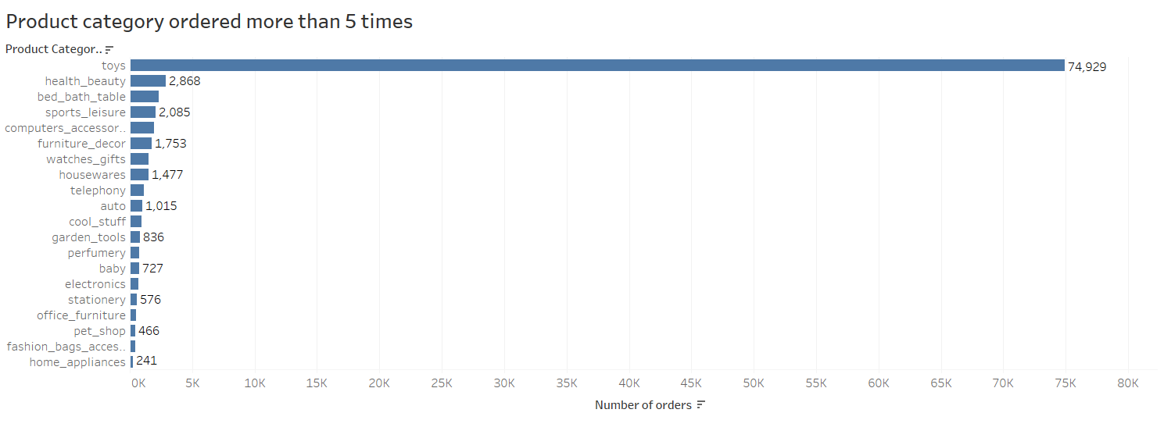
Product Category Ordered more than 5 Times
Toys category is the most ordered category with a total of 74,929 orders.
Health_beauty, bed_bath_table and sports_leisure are the next most ordered category.

Slide 11
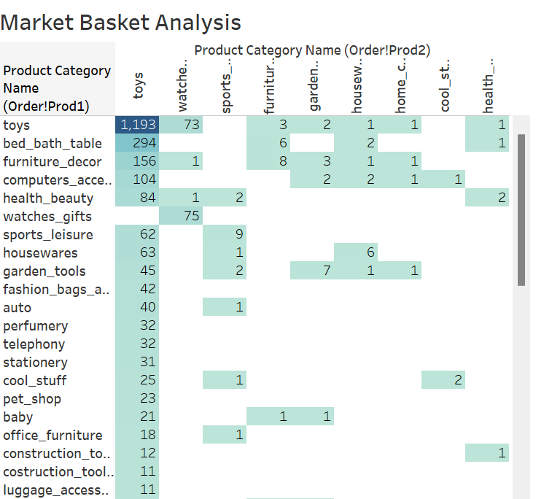
Market Basket Analysis
Market Basket Analysis is performed to identify the frequently ordered category association.
Toys are the most ordered category along with the categories of bed_bath_table, furniture_decor, computers_accessories and health_beauty.

Slide 12
Insights
The Toys category, comprising only 20% of our product offerings, commands a staggering 80% share of our revenue stream, showcasing its exceptional market dominance. Interestingly, even with premium pricing, these products continue to be highly sought-after by our customers, underscoring their intrinsic value and appeal.
Beyond Toys, we've identified bed_bath_table, furniture_decor, computers_accessories, and health_beauty and sports leisure as the other top contenders for frequent orders. Notably, these categories often find themselves alongside Toys in customers' shopping carts, indicating a cohesive consumer preference.
Moreover, our observations reveal a fascinating trend: despite their higher price points, certain products consistently attract significant purchase interest, reaffirming the importance of perceived value and quality in driving consumer decisions.

Slide 13
Recommendations
The company's strategic focus should prioritize categories responsible for over 80% of revenue, ensuring consistent stock availability to capitalize on their revenue-generating potential.
Targeting customer segments inclined towards toy purchases presents a lucrative opportunity for sales growth, given the high demand and frequency of orders within this category.
Implementing promotional codes or discounts on frequently ordered category associations can effectively stimulate cross-selling, thereby maximizing revenue opportunities across product lines.
In optimizing operational efficiency, consideration should be given to reducing sub-categories with minimal sales traction, streamlining product offerings to align with market demand and profitability objectives.

Slide 14
Appendix - Data Sources
Here is a snapshot of our Data Dictionary:
Order details such as order id, order status, order purchased timestamp, etc.
Order Items detail such as order item id, seller id, price, shipping charges, etc.
Customer details such as customer is, customer city, customer state, etc.
Payment details such as payment type, payment value, etc.
Product details such as product id, product category name, product dimensions, etc.
The following Data sources were used:
OList retail dataset

Slide 15
Appendix - Data Methodology
A meticulous analysis of the OList Retail Dataset was conducted, emphasizing thorough data cleaning and transformation. Python libraries, including Pandas and Numpy, were employed in the Jupyter Notebook environment to ensure accuracy and efficiency.
Missing values were strategically handled across various columns, optimizing data integrity through thoughtful replacements. Redundant and duplicate records were methodically identified and removed, retaining only the primary occurrences for enhanced clarity.
Exploratory data analysis was conducted using leading Python libraries such as Matplotlib and Seaborn within the Jupyter Notebook framework, enabling insightful visualizations and deeper insights into the dataset.
Additionally, a specialized dataset focusing on order ID and product category name was meticulously prepared for Market Basket Analysis, ensuring precision in identifying consumer patterns and product associations.
The utilization of Tableau facilitated the execution of comprehensive visualizations and Market Basket Analysis techniques, enriching the understanding of consumer behavior and facilitating informed business decisions.

Slide 16
Appendix - Data Assumptions
We exclusively analyzed cases marked with the order status 'delivered'.
It was presumed that the provided data accurately represents the desired revenue outcomes.
Expansion to new warehouses was not considered within the company's scope.
The company's strategies are formulated under the assumption of sustained sales growth.

Slide 17
Thank You

